Slide 1
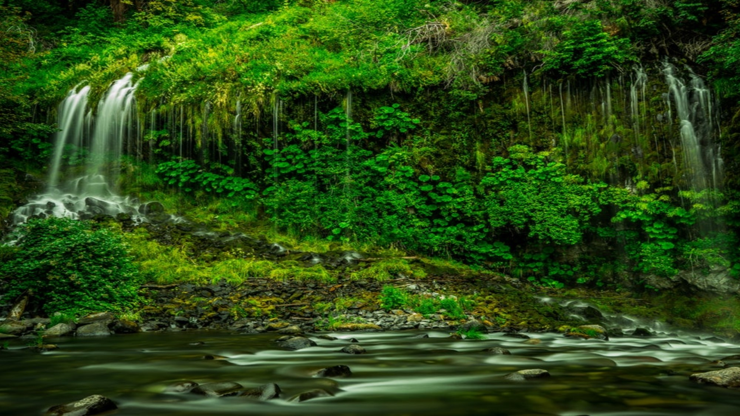
BIODIVERSITY

Slide 2
What is Biodiversity
The term biodiversity is made up of two words - bio and diversity.
Variability among living organisms from all sources (including terrestrial, marine and other ecosystems)
Convention on Biological Diversity (1992) in Rio Earth Summit-variability among living organisms from all sources including terrestrial, marine and other aquatic ecosystems and the ecological complexes of which they are a part
India ranks 10th among the plant rich countries of the world, 11th in terms of number of endemic species of higher vertebrates and 6th among the centers of diversity and origin of agricultural crops.

Slide 3
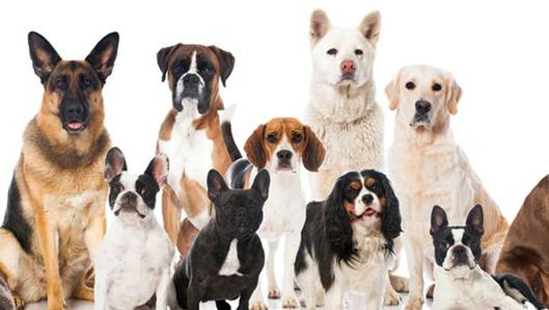
Levels of Biodiversity
Genetic diversity
  When the genes within the same species show different versions due to new combinations, it is called genetic variability.
  Variations among the genes of the same species are known as genetic diversity.
  It is this type of diversity that gives rise to the different varieties of rice, mangoes, dogs etc.

Slide 4
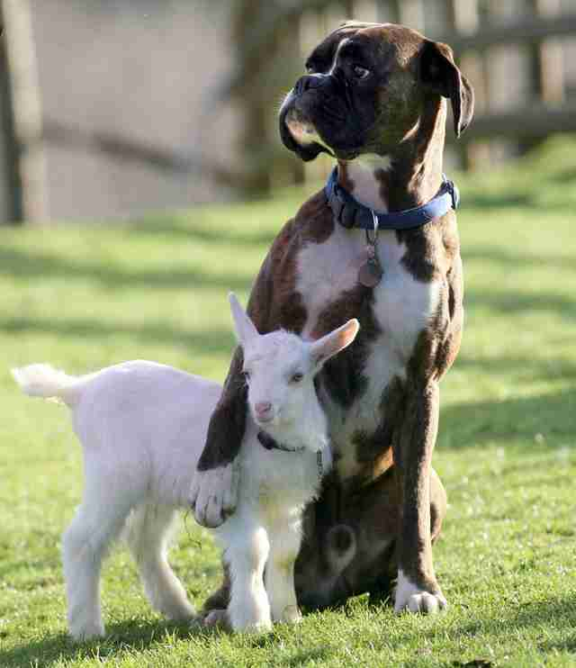
Levels of Biodiversity
Species Diversity
  Diversity which arises due to variations among species present in specific areas is called as ‘species diversity’.
  The variability found within the population of a species or between different species of a community
  Horses and donkeys are distinct species, as are lions and tigers.

Slide 5
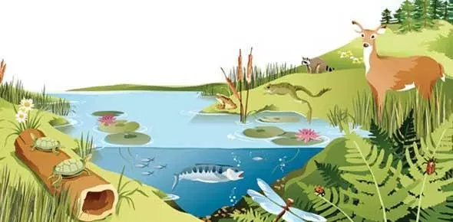
Levels of Biodiversity
Ecosystem Diversity
  Ecosystem diversity is the diversity of habitats which include the different life forms within.
  The term also refers to the variety of ecosystems found within a biogeographical political boundary.

Slide 6
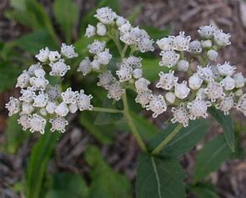
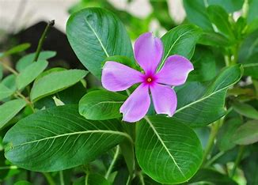
Values of biodiversity
Consumptive use Value
  Biodiversity product can be harvested and consumed directly.
  Food: About 80,000 edible plant species have been reported from wild.
  Drugs and medicines: About 75% of the world population depends upon different plants or plant extracts for medicines.
    Penicillin - antibiotic is derived from Penicillium (fungus).
    Tetracyclin from a bacterium.
    Quinine - malaria is obtained from the bark of Cinchona tree,
    Vinblastin and vincristine, two anticancer drugs obtained from Periwinkle (Catharanthus) plant
  Fuel: Coal, petroleum and natural gas are products of biodiversity

Slide 7
Values of biodiversity
Productive Value
  Different products are obtained from different organisms, like silk from silk-worm, wool from sheep, fir of many animals, lac from lac insects etc.
Ecological Services
  It refers to the services provided by ecosystems like prevention of soil erosion, prevention of floods, maintenance of soil fertility, cycling of nutrients, fixation of nitrogen, cycling of water, their role as carbon sinks, pollutant absorption and reduction of the threat of global warming etc.
  Biodiversity have enormous potential and a decline in biodiversity will lead to huge economic, ecological and socio-cultural losses.

Slide 8
Values of biodiversity
Ethical and Aesthetic Value
  Many of the plants are considered holy and sacred in our country like Tulsi, Peepal etc.
  The ethical value means that we may or may not use a species but knowing the very fact that this species exists in nature gives us pleasure.
  People from far and wide spend a lot of time and money to visit wilderness areas where they can enjoy the aesthetic value of biodiversity and this type of tourism is now known as eco-tourism.

